Slide 1


Prepared for University Name DATE
University Name State University
P R O P O S A L
Integrated Student Search Solution

Slide 2
Today’s Agenda
Welcome
About Carnegie
Carnegie Student Search
Proposed Approach
Project Overview
Questions and Conversation
Together we will build a comprehensive, data-driven, and market-centric Student Search solution for University Name .
Notes:
Jim and our connections to area and campus

Slide 3

About Carnegie

Slide 4
Carnegie’s Innovative History
1985
2009
2018
2021
2022
2023
+ LEAD GEN
+ DIGITAL
+ BRAND + CREATIVE
+ SLATE + WEB
+ MODELING
+ EM STRATEGY
Carnegie begins with, and is well known for, high quality lead generation tactics connecting students and universities.
Carnegie becomes the first firm to offer digital marketing services focused on higher education.
Carnegie merges with Dartlet, bringing advanced Psychometrics to higher education to develop powerful brand platforms and differentiated creative.
Carnegie leans into concept that your website is your most powerful recruitment tool and invests in mStoner, a leader in higher education website design and development.
Carnegie develops ability to work within Slate through Underscore acquisition.
Carnegie acquires distinct talent to rethink Individualized financial aid modeling.
Carnegie bolsters their Enrollment Strategy talent with the acquisition of Fire Engine Red.
For more than 35 years, Carnegie has been recognized as a leader and innovator in higher education marketing and enrollment strategy, and we’ve undergone thoughtful, and strategic growth to support the future of higher education.
Notes:
Kelsey

Slide 5

Comprehensive Services
We can meet you wherever you are in your journey. Consider our team an extension of your own — focused on your needs, dedicated to your success.
BRAND STRATEGY
DIGITAL MARKETING
ENROLLMENT STRATEGY
FINANCIAL AID OPTIMIZATION
INTEGRATED RESEARCH
LEAD GENERATION
MARKETING STRATEGY
PERSONALITY ASSESSMENTS
SIGNATURE CREATIVE
SLATE OPTIMIZATION
STUDENT SEARCH
WEB DESIGN & DEVELOPMENT
Notes:
Kelsey

Slide 6

Students choose how, when, and where to engage
“We want more specific details in marketing. We get it, you have a 12:1 student-to-faculty ratio. So do dozens of other schools. Tell me what’s unique about your school.”
CollegeXpress, Student Survey
38% of surveyed seniors said that they would not consider an online undergraduate experience. This percentage went up since pre-pandemic times.
Notes:
Kelsey
This lack of interest in online or hybrid programming tells us that these students are yearning to connect with others.
Environmental changes/pressures, particularly in the NE (MA expects a 5-10% decrease in college age going student population over the next decade)
While there’s an increase of pressure for more personalized messaging and experiences

Slide 7

Notes:
Kelsey

Slide 8



Notes:
Kelsey

Slide 9

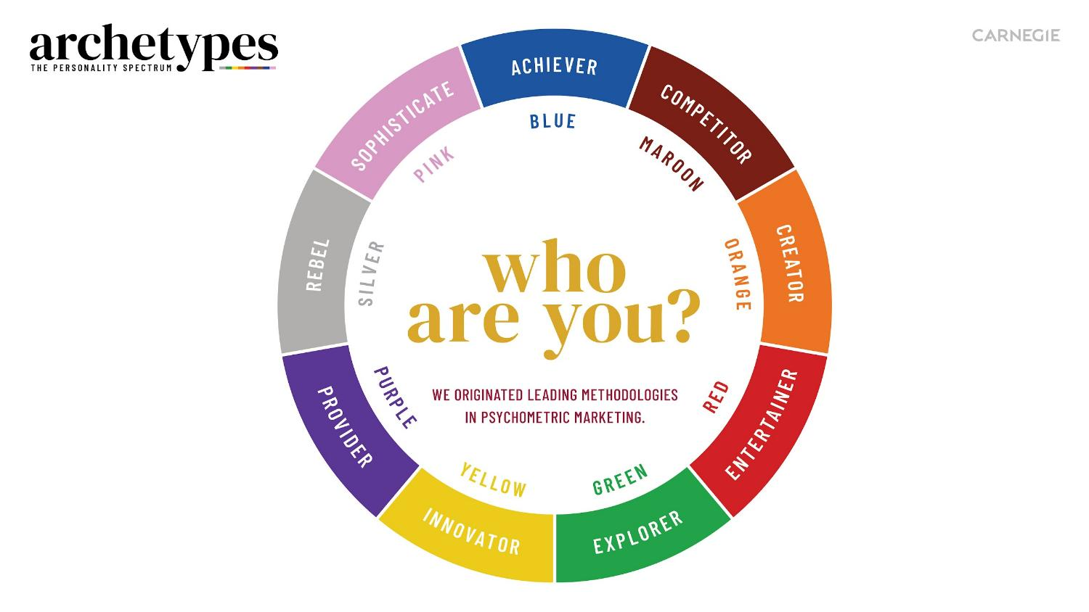

Notes:
Kelsey

Slide 10


Notes:
Kelsey

Slide 11
Facts and statistics aren’t enough. You have to tell a story.
Your story.
Notes:
Kelsey

Slide 12
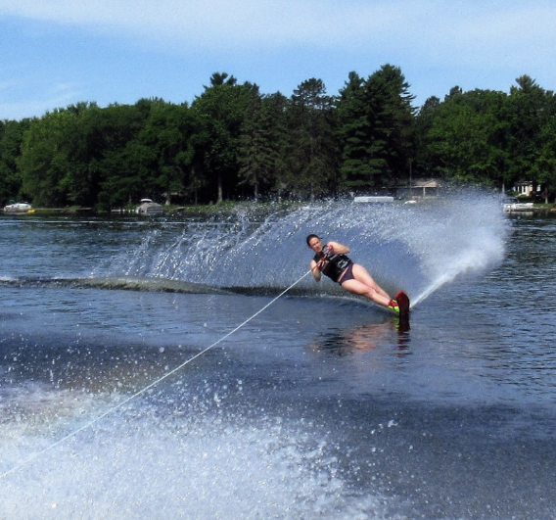
Notes:
Kelsey

Slide 13

Notes:
Kelsey

Slide 14

Notes:
Kelsey

Slide 15


Notes:
Kelsey
This emotive storytelling develops a deeper connection between humans, between me and you, between you and your prospective families.

Slide 16

Traditional Student Search
Name Sourcing
Emails
Mailings
Reports
Volume limited
UNIVERSITY LOGO
FUN BUT GENERIC HOOK
Visit or Apply
Notes:
Trent Everyone search proposal will offer you these things–and ours does too. We want to show you what make Search with Carnegie
Add details here for talk track.
#1
Our traditional sources for student records and data are decreasing. So we need to diversify our inquiry sources, and meet students where they are spending time.
Privacy Laws
Common Datasets
Direct Admit
SCOTUS
FAFSA Changes
Rich Data Requirement
#2
Gen Z and Gen Alpha—These students were born knowing how to swipe. They have always had a 24 hour news cycle. They are the most diverse population we have ever recruited. Their Bullsh*t detectors are sharp—Trust will not be given without transparency and authenticity. They purchase along their value lines and are actively re-defining the status-quo.
Values-based Purchasing
Mission & Culture
Authenticity Radar
Politics & Society
Genuineness in Brand
Curated Experiences
#3
With declining numbers of high school grads, institutions across the country moved to explore recruitment outside their traditional footprints, in additional programs and new audiences. This increased competition and for the student meant that they were/are inundated with college messaging…making most of it white noise. For us it became more difficult to gain the attention of our most important audience.
Increased Competition
Demographic Compression
Modality Exploration
Program Consolidation / Expansion
New Market Exploration
Audience Expansion
#4
This is the trend that underscores all the rest. The students are in control now. Their relationship with us is not linear, their channels are maybe not our channels.. To respond we must be:
Multi-channel
Yield-focused
Multi-cycle, Non-Linear
Year Round
Segmented and Personalized
Marketing and Enrollment
#5
Experience economy refers to the evaluation (and comparison) of the various interactions we have with brands. Not just attention and engagement, but did I enjoy it? Was it memorable? Did it cause me to think? Experiences go beyond the tour of visit and extend into the web, customer service, timeliness, etc.
Archive:
Ben’s comment: I am adding this for your consideration. Perhaps it falls into expectation of authenticity, but it is pretty important IMHO
TREND #5
Attention and Experience Economies
CK reply: I think attention economies wraps in to market share and authenticity...what do you mean by experience economies?

Slide 17

today’s environment
IS INCREASINGLY COMPETITIVE
ELUSIVE
CONSUMER
SHIFTING DEMOGRAPHICS
QUESTIONING
VALUE AND COST
STUDENT
POPULATION
DECLINE
FINANCIAL PRESSURE
NEW COMM
CHANNELS
LIMITED
ATTENTION
OUTCOMES
FOCUS
Notes:
Trent

Slide 18

Less like this
Notes:
Trent

Slide 19
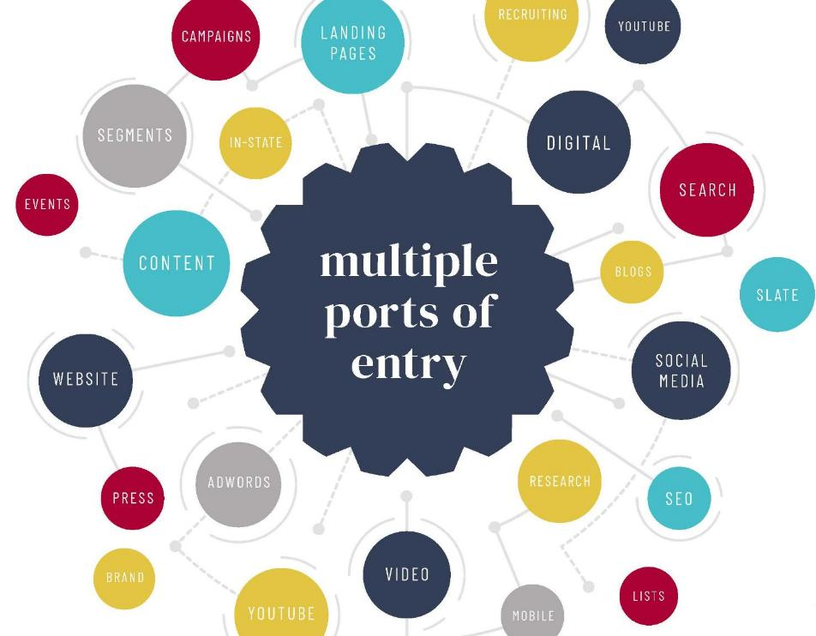
More
like this
Notes:
TRENT

Slide 20
Yield-focused Approach to Student Search
Tip the scale
Recruit with purpose
Use personality to personalize
Capture attention
Campaigns should be agile
Drive engagement
Data should be owned and available
Gain a competitive edge
Resources should be used efficiently
Leverage predictive and actionable data
Your Student Search should be custom crafted
Pair your institutional knowledge with our best-in-class services
It’s more than “Search”
Combine smart enrollment and marketing strategies
University Name | Student Search
20
Notes:
Trent
Fit is fundamental
Recruit your best-fit students by using market research to inform prospect acquisition and predictive modeling to identify those with greater propensity to take action.
ALT: Enrollment management today is so much more than search response and application generation. It’s Marketing and Enrollment Strategy. We support the full enrollment journey, to support your enrollment aspirations, by increasing engagement and conversions, and ultimately yielding your class.
ALT:This full life cycle approach to Student Search will increase conversions at every stage of the student journey, and ultimately yield your class.
Alt Language: We have fewer prospective students with higher expectations in a hypercompetitive landscape in which rock-climbing walls are table stakes.
It’s time to differentiate or dwindle. To go beyond baseline demographics and toward data that provides real insights into what motivates your best-fit students. You need diversified sources, a digital-first approach and a sustainable strategy.
We’ve got you covered. Let’s do this.

Slide 21
Tailored,
Not Templated
YIELD STRATEGIES
STRATEGIC
LEAD
SOURCING
We offer full enrollment life-cycle solutions purpose-built for today’s higher education landscape. Your solution will be customized to answer your most pressing marketing and enrollment needs.
ENGAGEMENT
SCORING
University Name
STUDENT
SEARCH
PSYCHOGRAPHIC SEGMENTATION
REAL-TIME
PERFORMANCE REPORTING
DYNAMIC MULTICHANNEL CAMPAIGNS
Notes:
TRENT

Slide 22
University Name Proposed Approach
Notes:
Trent Everyone search proposal will offer you these things–and ours does too. We want to show you what make Search with Carnegie
Add details here for talk track.
#1
Our traditional sources for student records and data are decreasing. So we need to diversify our inquiry sources, and meet students where they are spending time.
Privacy Laws
Common Datasets
Direct Admit
SCOTUS
FAFSA Changes
Rich Data Requirement
#2
Gen Z and Gen Alpha—These students were born knowing how to swipe. They have always had a 24 hour news cycle. They are the most diverse population we have ever recruited. Their Bullsh*t detectors are sharp—Trust will not be given without transparency and authenticity. They purchase along their value lines and are actively re-defining the status-quo.
Values-based Purchasing
Mission & Culture
Authenticity Radar
Politics & Society
Genuineness in Brand
Curated Experiences
#3
With declining numbers of high school grads, institutions across the country moved to explore recruitment outside their traditional footprints, in additional programs and new audiences. This increased competition and for the student meant that they were/are inundated with college messaging…making most of it white noise. For us it became more difficult to gain the attention of our most important audience.
Increased Competition
Demographic Compression
Modality Exploration
Program Consolidation / Expansion
New Market Exploration
Audience Expansion
#4
This is the trend that underscores all the rest. The students are in control now. Their relationship with us is not linear, their channels are maybe not our channels.. To respond we must be:
Multi-channel
Yield-focused
Multi-cycle, Non-Linear
Year Round
Segmented and Personalized
Marketing and Enrollment
#5
Experience economy refers to the evaluation (and comparison) of the various interactions we have with brands. Not just attention and engagement, but did I enjoy it? Was it memorable? Did it cause me to think? Experiences go beyond the tour of visit and extend into the web, customer service, timeliness, etc.
Archive:
Ben’s comment: I am adding this for your consideration. Perhaps it falls into expectation of authenticity, but it is pretty important IMHO
TREND #5
Attention and Experience Economies
CK reply: I think attention economies wraps in to market share and authenticity...what do you mean by experience economies?

Slide 23
We will create a solution designed to:
Grow new student enrollments over the next few years through a stronger inquiry pool.
Integrate data within University Name State’s Slate instance.
Maintain and enhance the geographic, socioeconomic, and programmatic diversity of inquiry and applicant pools.
Reach prospective students earlier in the college selection process.
Increase awareness and affinity for University Name in existing and new markets.
Infuse rich data into your Student Search efforts for better strategic decision making, in flight and year over year.
Dynamically engage with students at various entry points throughout your ecosystem.
Together we will collaborate
To Deploy a Modern, Yield-Focused Student Search Solution
Notes:
Jim

Slide 24
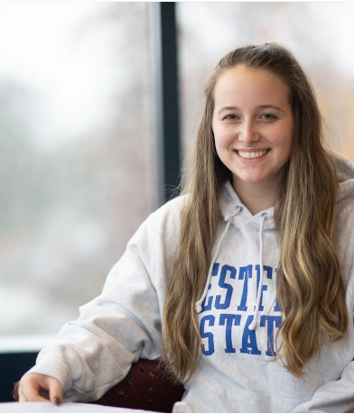
Strategic Lead Sourcing
lead generation strategy
Student Centric
Market Mindful
Diversified Sourcing
Yield Focused
Lead Scoring
University Name Photo
Name buy recommendations and sourcing strategy are based on:
Your enrollment data
Market research
Channel analysis
Your input and enrollment goals
We follow up with Lead Scoring to:
Maximize your resources and results
Inform communication segmentation, recruitment plans, direct mail volumes, and more
+ Enrollment Strategy Consulting
+ Lead Sourcing Strategy
+ Student Database Access
+ Market Opportunity Index
+ College Board Connections
University Name | Student Search
24
Notes:
Trent

Slide 25
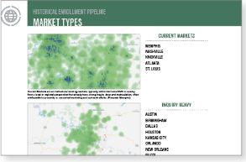
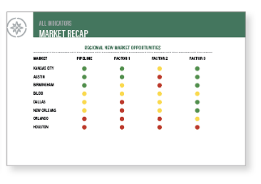

Lead Sourcing
Strategic Name Buy
Student Database Access
Market Opportunity Index
Comprehensive Sourcing
Regional and National Trends
Fully Integrated into Slate
Qualified Inquiries
Free and Accessible to Students
Direct Slate Integration
Identify Target Markets
Access Rich Demographic Data
Apply to Travel, Digital, Reporting
Notes:
Kelsey

Slide 26
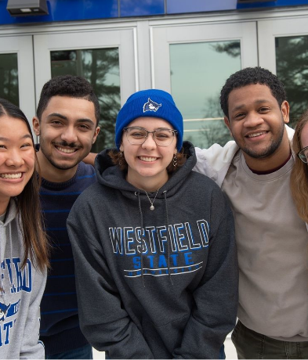
Psychographic Segmentation
content strategy
Content Strategy Road Map
Variable Communications
Personalized Fulfillment
Slate Integration
University Name Photo
University Name State Student Search
Deliver personalized experience students are asking for and stand apart from your competition.
We will combine student demographic data with psychographic data–like personalities, motivations, and beliefs
Deliver student profiles and custom audience segmentation which ensures your Student Search campaigns capture attention.
+ National Student Profiles
+ Historic Matriculant Data
+ Authentic and Variable Content
University Name | Student Search
26
Notes:
Kelsey

Slide 27






Turnkey Psychographic Segmentation | Motivators
3 NATIONAL PROFILES
MONTHLY TAGGING PROCESS
VARIABLE CONTENT FULFILLMENT
Notes:
Kelsey IP Targeting Impact
Across all audience segments, the new Darted campaigns outperformed their original non-Darted campaigns
Dart segmentation had the biggest effect on the Junior and Admit audiences
Aggregated with all audiences together, IP Targeting typically sees a 31% lift in engagement with Dart segmentation
Snapchat
Dart segmentation had most effect on the Junior audience
Aggregated with all audiences together, Snapchat achieves about a 20% lift in engagement with Dart segmentation
If Dart strategy is deployed beyond just lists for Snapchat (used in behavioral audience targeting as well) there's an even greater lift of 43%
Email Client A (Private, R1 University, 2,400 students, West):
Increased YOY Deposits, +18% Net Deposits (22-23 cycle)
Darted Comms Increased Conversion, 17% Better Yield (45% vs 28% non-Darted)
Increased Inquiry Conversion on Darted Names, 13% Higher Conversion (app gen)
Email Client B (Public R2 University, 17,000 Students, Midwest):
Increased Search Yield Conversion, 30% App-to-Enroll (vs 16% total)
Darted Comms Increased Conversion, 29% Better Yield (at all stages)
Increased YOY Deposits, +6% Deposits (May 1)

Slide 28

Clear Campaign Execution
fulfillment strategy
University Name State Search Campaigns
Senior Search
15 emails; up to 5 segments
Underclassman Search
20 emails; 3 subpopulations; up to 5 segments
Application Generation
15 emails; up to 5 segments
Incomplete App–awaiting submission
5 emails; 2 segments
Incomplete App–awaiting materials
5 emails; 2 segments
Campaign Postcards (6x9)
3 segmented–deployed in conjunction with strategy
Transfer
15 emails; up to 3 segments
Search Campaigns
App Generation
App Completion
Transfer Campaign
University Name Photo
+ Campaign set up in your Slate instance
+ Complete Data Transparency
+ Fully Supported Throughout
University Name | Student Search
28
Notes:
Trent

Slide 29
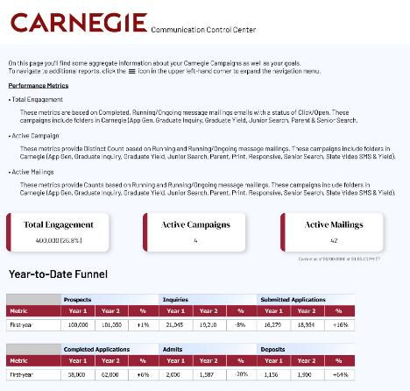
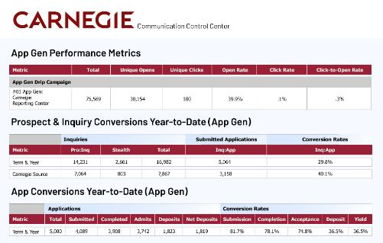
Real-Time Performance Reporting
Transparent Reporting
Slate configured and hosted reporting
Availability in real-time
24/7 Direct Access to Data
Continuous optimization during engagement
Notes:
Trent

Slide 30
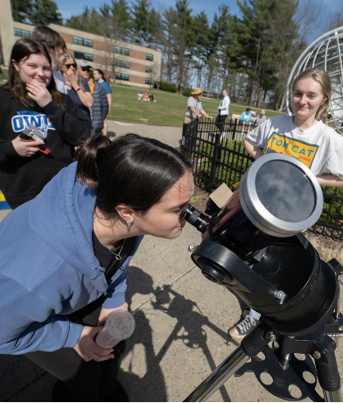
Dynamic Multi-channel Campaigns
digital marketing strategy
University Name State Student Search
We'll deliver the right message to your Student Search audience at precisely the right time.
Awareness Campaigns
Brand Elevation
List-based Digital
Cycle-based Tactics
University Name Photo
+ Optimizations based on Performance
+ Transparent Reporting and Benchmarks
+ Sophisticated and Targeted Digital
University Name | Student Search
30
Notes:
Jim

Slide 31


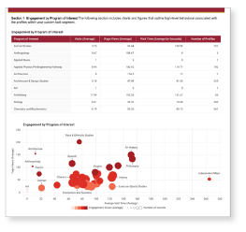
Dynamic Multi-channel Campaigns
List Based Digital
Full Life-cycle Tactics
Transparent Reporting
Leverage motivator Segmentation
Target Specific Conversions
Retarget Audiences
Always On Approach
Elevate Brand Awareness
Integrated Strategies
Ongoing Optimizations
ROI-based Recommendations
24/7 Direct Access to Data
Notes:
Jim

Slide 32
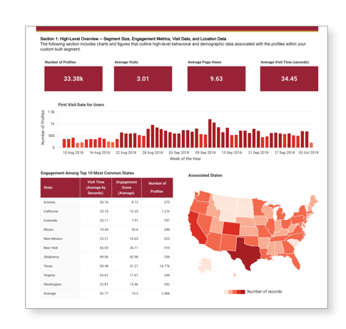
Website Personalization and Attribution
Carnegie Clarity
Marketing Attribution
Behavioral Tracking
Connection to Slate to provide all marketing and enrollment data in one place
Website Personalization based on:
Campaign interaction
Program of interest
Demographic information
Website behavior
Position in funnel

Slide 33
Project Overview

Slide 34
Essential
Relationships
ENROLLMENT STRATEGIST
CLIENT SUCCESS LEADER
Your core team at Carnegie will include the Enrollment Strategist, Client Success Leader, and Account Manager.
Deep bench of expertise:
Slate experts
Digital strategists
Graphic designers
Writers
Web experts
Enrollment Strategist: Your strategic partner in shaping enrollment, analyzing performance and optimizing your Student Search efforts year-after-year.
Client Success Leader: The concierge to your Carnegie experience will be with you every step of the way, ensuring that our work aligns with your goals and priorities.
ACCOUNT MANAGER
Account Manager: Comprehensive partnerships require meticulous attention to detail and process. Your Account Manager will ensure smooth communication and adherence to established timelines.
Notes:
Kelsey

Slide 35






Our Proposed Process
DISCOVER
STRATEGIZE
ACTIVATE
MEASURE
OPTIMIZE
In discovery, we’ll review project goals, timelines, and dive into your brand voice, data set-up, and more.
We’ll derive insight from the Discovery process and create a custom, tailored Student Search Strategy for you.
We’ll produce persona driven creative assets and then deploy them throughout your enrollment ecosystem.
After deployment we’ll provide you with regular reports and recommendations for campaigns in flight.
Iterative improvement is essential to maximizing your efforts over time. We will provide ongoing consultation.
Notes:
Kelsey

Slide 36
Proposed Project Plan
In the Discover Phase, we will:
Analyze historical data to inform Market Opportunity Index, Carnegie Motivators, and name buy strategy
Discuss enrollment goals and target markets which will influence name buys and communication plans
Access and explore University Name State’s Slate instance to prepare for set up of email campaigns, reporting and more
Review University Name State’s branding guidelines and past enrollment collateral, which will be thoroughly incorporated into all creative work
DISCOVER
In discovery, we’ll review project goals, timelines, and dive into your brand voice, data set-up, and more.
Notes:
Trent

Slide 37
Proposed Project Plan
In the Strategize Phase, we will:
Collaborate to create communication plans for drip email campaigns
Review the Enrollment and Lead Sourcing Strategy analysis and report
Share insights gained from the Market Opportunity Index and Carnegie Motivators
STRATEGIZE
We’ll derive insight from the Discovery process and create a custom, tailored Student Search Strategy for you.
Notes:
Trent

Slide 38
Proposed Project Plan
In the Activate Phase, we will:
Finalize creative designs and Motivator-segmented copy to be deployed in email messages, print, and digital ads
Launch email drip campaigns
Establish name buy cadence and add new prospects into campaigns
Automate the import/export of student data through University Name State’s Slate instance to streamline lead acquisition and Clarity marketing attribution
ACTIVATE
We’ll produce persona driven creative assets and then deploy them throughout your enrollment ecosystem.
Notes:
Trent

Slide 39
Proposed Project Plan
In the Measure & Optimize Phases, we will:
Meet monthly with your Enrollment Strategist to discuss list buys and overall health of campaign
Meet biweekly with your Slate Strategist to discuss recent email performance and funnel metrics
Regularly monitor campaigns behind the scenes and optimize as needed
Keep in constant contact to evaluate progress toward cycle goals, discussing potential pivots as needed
Provide high-level metrics for stakeholders as needed, including a comprehensive annual campaign review
MEASURE
OPTIMIZE
After deployment we’ll provide you with regular reports and recommendations for campaigns in flight.
Iterative improvement is essential to maximizing your efforts over time. We will provide ongoing consultation.
Notes:
Trent

Slide 40
Carnegie Student Search Timeline
MAY | JUN | JUL | AUG | SEP | OCT | NOV | DEC | JAN | FEB | MAR | APR
CARNEGIE SELECTED & CONTRACT SIGNED
CONTRACT BEGINS
CAMPAIGN LAUNCH
ACTIVATE
DISCOVER
STRATEGIZE
MEASURE/OPTIMIZE
Notes:
Jim

Slide 41
Investment Summary
Core Student Search Investment
CollegeXpress Lead Generation | Connecting with prospective students at every stage of their journey is more challenging than ever before. CollegeXpress is the go-to resource for college and scholarship searches for millions of students, parents, and counselors, which is why it’s a trusted tool for hundreds of institutions. | $270,300
Enrollment & Lead Sourcing Strategy | This enrollment analysis and strategy plan will inform decision-making processes with specific recommendations relative to student search and contribute to the optimization of enrollment strategies.
Full Lifecycle Slate Communications + Transfer Campaign | Tailor any Slate communications based on academic, demographic, psychometric, and custom data points and generate connections with highly relevant messages. No data transfers involved and real-time campaign reporting is built in.
Psychographic Segmentation - Carnegie Motivators | Proprietary methodology that will tag your prospect and inquiry lists with what psychographic motivator they will most resonate with to guide your communication segmentation strategy.
Lead Scoring | Custom modeling predicting inquiry-to-applicant conversion to inform your team's outreach priorities. Inclusive of regular tagging of current Inquiries to signal likelihood to convert, delivered weekly until census.
Digital Marketing Investment
Full Funnel Digital Execution | Strategy, execution, and management of all paid digital media. Set up across all digital platforms including keyword research, creation of target audiences, development of all copy and ad text, including testing variations, bidding strategies, etc. Access to a live dashboard to monitor digital campaigns as well as ongoing analysis from Digital team, including performance insights, trends, and recommendations when applicable. | $125,000
Notes:
TRENT–Land the plane and open for questions

Slide 42
Multi-year Discounts
Multi-year Partnership | Core Student Search Investment | Proposed Digital Costs | Total
Total Annual Investment 1 Year Partnership | $270,300 | $125,000 | $395,300/year
Total Annual Investment 2 Year Partnership | $263,450/year | $125,000/year | $388,450/year
Total Annual Investment 3 Year Partnership | $256,600/year | 125,000/year | $381,600/year
Total Annual Investment 5 Year Partnership | $245,239/year | 125,000/year | $370,239/year

Slide 43
Tailored,
Not Templated
YIELD STRATEGIES
STRATEGIC
LEAD
SOURCING
We offer full enrollment life-cycle solutions purpose-built for today’s higher education landscape. Your solution will be customized to answer your most pressing marketing and enrollment needs.
ENGAGEMENT
SCORING
University Name
STUDENT
SEARCH
PSYCHOGRAPHIC SEGMENTATION
REAL-TIME
PERFORMANCE REPORTING
DYNAMIC MULTICHANNEL CAMPAIGNS
Notes:
TRENT

Slide 44
Case Studies + Metrics

Slide 45
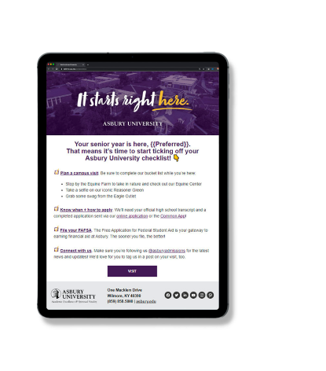
Asbury
University
Measure, Optimize, and see Results:
Increase Inquiry Yield
33.5% v. 30.4% the previous year
Increase in Deposits by 20%
Overall 25% increase in net revenue
Profile
Class of 2027 boasts highest average GPA
Increase of 5% in representation from students in bordering states
Private
1,400 Students
Wilmore, Kentucky
Brand Strategy
Darts
Campaign Concepts
Video and Photo
Senior Search
So/Jr Search
Financial Aid Strategy
Notes:
\

Slide 46
Aggregated
Metrics
Measure, Optimize, and see Results:
IP Targeting Impact
31% lift in engagement with Dart segmentation
Dart segmentation had the biggest impact on Junior and Admit audiences
Snapchat
20% lift in engagement with Dart segmentation
If used beyond list-based targeting (leveraging behavioral) there is a greater lift of 43%
Dart segmentation had the biggest impact on the Junior audience
Digital Data
Darted Metrics
Notes:
IP Targeting Impact
Across all audience segments, the new Darted campaigns outperformed their original non-Darted campaigns
Dart segmentation had the biggest effect on the Junior and Admit audiences
Aggregated with all audiences together, IP Targeting typically sees a 31% lift in engagement with Dart segmentation
Snapchat
Dart segmentation had most effect on the Junior audience
Aggregated with all audiences together, Snapchat achieves about a 20% lift in engagement with Dart segmentation
If Dart strategy is deployed beyond just lists for Snapchat (used in behavioral audience targeting as well) there's an even greater lift of 43%

Slide 47
Case Study
Client A
Dart Impact
Measure, Optimize, and see Results:
Increased YOY Deposits
+18% Net Deposits (22-23 cycle)
Darted Comms Increased Conversion
+17% Better Yield (45% vs 28% non-Darted)
Increased Inquiry Conversion on Darted Names
+13% Higher Conversion (app gen)
Private R1 University
2,400 Students
Western United States
Notes:
Email Client A (Private, R1 University, 2,400 students, West):
Increased YOY Deposits, +18% Net Deposits (22-23 cycle)
Darted Comms Increased Conversion, 17% Better Yield (45% vs 28% non-Darted)
Increased Inquiry Conversion on Darted Names, 13% Higher Conversion (app gen)

Slide 48
Case Study
Client B Dart Impact
Measure, Optimize, and see Results:
Increased Search Yield Conversion
+30% App-to-Enroll (vs 16% total)
Darted Comms Increased Conversion
+29% Better Yield (at all stages)
Increased YOY Deposits
+6% Deposits (May 1)
Public R2 University
1,700 Students
Midwest United States
Notes:
Email Client B (Public R2 University, 17,000 Students, Midwest):
Increased Search Yield Conversion, 30% App-to-Enroll (vs 16% total)
Darted Comms Increased Conversion, 29% Better Yield (at all stages)
Increased YOY Deposits, +6% Deposits (May 1)

Slide 49

210 Littleton Road, Suite 100 Westford, MA 01886
978.692.5092
carnegiehighered.com
info@carnegiehighered.com

